Slide 1



HOME
OBJECTIVE
DATA
METHODOLOGY
RESULTS
CONCLUSION
RENEWABLE
ENERGY
Mina Carbajal
Carmen Morales-Mier
Gaayathri Rayapaneni
Ignatius Jonathan Sugijono
IFI 8420

Slide 2



Table
of Contents
Introduction
Objective
Data & Preparation
Forecast solar and wind energy using machine learning.
Build models to predict energy growth for better investment decisions.
Datasets used and how data was cleaned and prepared.
Risk Factors
ML Models
Results
Energy output is affected by weather, policy changes, and data gaps.
Models used: Linear Regression, Random Forest, SVR.
Model performance on solar and wind forecasts.
Model Comparison
Conclusion
Compare accuracy and reliability of all models.
Key takeaways and recommendations

Slide 3


HOME
OBJECTIVE
DATA
METHODOLOGY
RESULTS
CONCLUSION
Problem Statement
Can we confidently forecast solar energy growth to considering environmental risks and policy changes, to support strategic financial and operational decisions?
Assess whether the U.S. solar energy sector will see continued growth in the near future.
Evaluate how external risk factors like severe weather and public investment affect energy output.
Support data-driven financial decisions for investment planning, capacity expansion, and policy response.
Key Business Questions
How will solar energy generation evolve in the next 5-10 years?
What are the primary drivers and risks to solar output?
How can predictive models assist in financial and operational decision-making?

Slide 4







HOME
OBJECTIVE
DATA
METHODOLOGY
RESULTS
REFERENCES
DATA
EIA Monthly Energy Generation
PV Plant & Extreme Weather Dataset
Investing in America (IIA) Public Investments Data
U.S. Renewable Energy Consumption Data
EIA Open Data API
Solar energy output by U.S. state and producer type (commercial, residential, etc.).
Tracks weather-related disruptions at solar plants: wind speed, rainfall, duration of maintenance delays.
Federal/state funding by project type, location, and sector.
Longitudinal data by sector (residential, industrial, transportation).
Used pagination and filtering to pull >220,000 rows of energy data across multiple years and metrics.
51,000 rows covering every state and energy source monthly
38 columns, 51,505 rows of detailed plant performance data.
Used to assess investment impact on solar adoption by region.
Key to identifying evolving demand trends for solar integration.
Dynamic data extraction (220,000+ rows).

Slide 5




HOME
OBJECTIVE
DATA
METHODOLOGY
RESULTS
CONCLUSION
Data Engineering
Filtered, cleaned, and merged datasets by state and date.
Removed incomplete and zero-output entries.
Created derived metrics:
Storm duration, wind speed, investment intensity.
Aggregated monthly and annual trends for analysis.
Key Risk Factors
Weather Disruption: Storms and wind reduce output.
Policy Volatility: Changes in investment levels shift growth patterns.
Data Gaps: Grid capacity and infrastructure not fully captured.
Forecast Horizon: Accuracy declines beyond 18 months.
Analytical Approach
Linear Regression – Baseline trend analysis
Random Forest Regression – Non-linear relationships
Support Vector Regression (SVR) – Stability under volatility

Slide 6
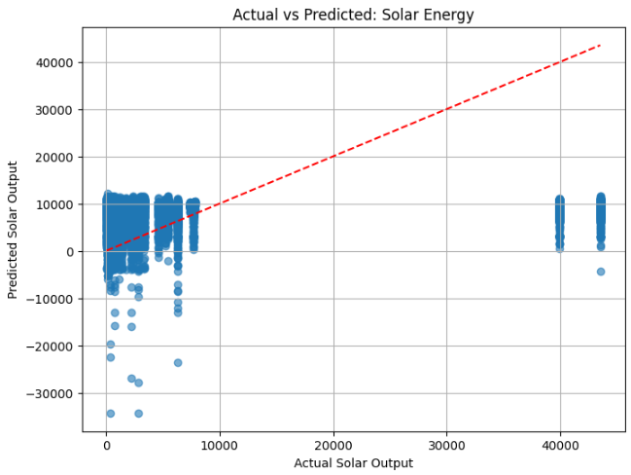
HOME
OBJECTIVE
DATA
METHODOLOGY
RESULTS
CONCLUSION
LINEAR REGRESSION
SOLAR
R² Score: 0.03661651691218493
Mean Absolute Error (MAE): 10081.298277645034
Mean Squared Error (MSE): 195908899.7776904
Root Mean Squared Error (RMSE): 13996.746042480388
Detected a weak and inconsistent trend in solar output.
Failed to adjust to variations caused by extreme weather and investment shifts.
R² = 0.0366 | RMSE = 13,996.75
Insights:
Solar energy’s growth could not be captured reliably with a linear approach.
Oversimplified model fails to incorporate key external drivers like storms or government incentives.
Not reliable for forecasting solar trends, especially in dynamic or risk-sensitive environments.

Slide 7
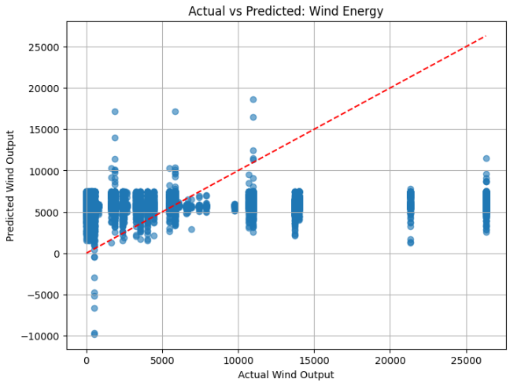
HOME
OBJECTIVE
DATA
METHODOLOGY
RESULTS
CONCLUSION
LINEAR REGRESSION
WIND
R² Score: 0.009124303254554378
Mean Absolute Error (MAE): 6102.032719676462
Mean Squared Error (MSE): 51351704.32428156
Root Mean Squared Error (RMSE): 7166.010349160931
Struggled to capture irregular wind patterns.
Seasonal variation not effectively modeled; fluctuations led to inaccurate outputs.
R² = 0.0091 | RMSE = 7,166.01
Insights:
Wind energy’s natural variability limits linear forecasting reliability.
Fails to account for rapid wind speed changes or storm impacts.
Avoid for financial planning involving wind energy; linear models are better suited to more stable energy sources.

Slide 8
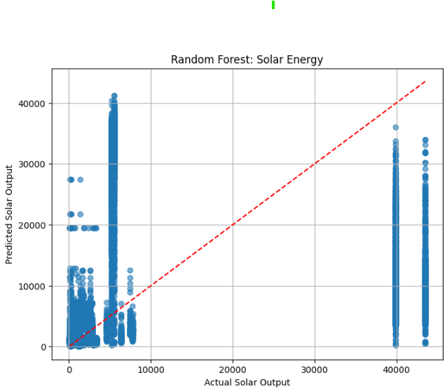
HOME
OBJECTIVE
DATA
METHODOLOGY
RESULTS
CONCLUSION
RANDOM FOREST REGRESSION
SOLAR
R² Score: -0.19017009725193423
Mean Absolute Error (MAE): 9533.320277655836
Mean Squared Error (MSE): 242027103.84196982
Root Mean Squared Error (RMSE): 15557.22031218848
Failed to capture meaningful trends in solar energy output.
Model overfit to noise and underperformed even in relatively stable conditions.
R² = -0.1901 | RMSE = 15,557.22
Insights:
Complexity of the model did not translate to better predictions.
Likely caused by insufficient or misaligned features with solar dynamics.
Current form is not effective; requires refined features or additional data for solar forecasting.

Slide 9
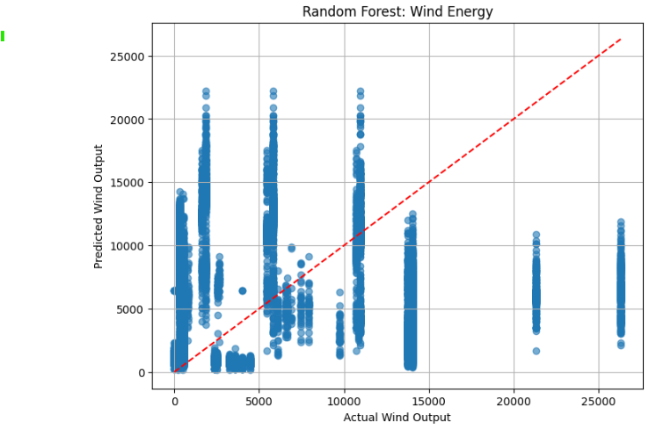
HOME
OBJECTIVE
DATA
METHODOLOGY
RESULTS
CONCLUSION
RANDOM FOREST REGRESSION
WIND
R² Score: -0.5194619631386619
Mean Absolute Error (MAE): 7176.754082212164
Mean Squared Error (MSE): 78745458.91010381
Root Mean Squared Error (RMSE): 8873.863809530987
Performed poorly in modeling wind output, overfitting to noisy data.
Unable to generalize wind variability, leading to large forecast errors.
R² = -0.5194 | RMSE = 8,873.86
Insights:
Model failed to adapt to rapid and irregular wind fluctuations.
Current configuration cannot be used for wind energy forecasts.
Requires significant rework, possibly including temporal or lag-based features.

Slide 10
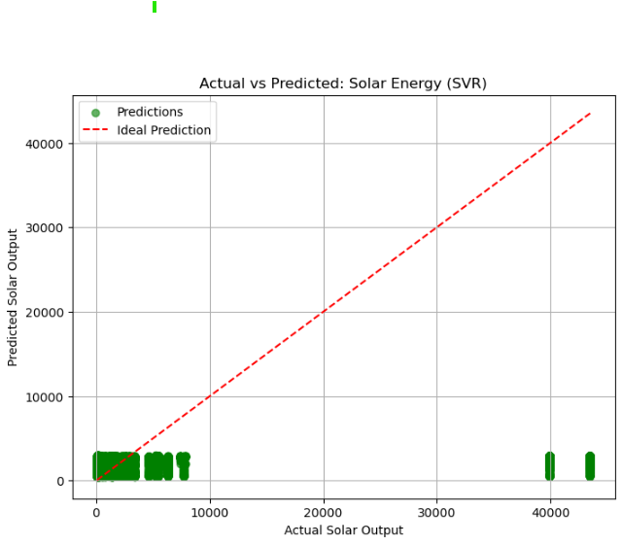
HOME
OBJECTIVE
DATA
METHODOLOGY
RESULTS
CONCLUSION
SUPPORT VECTOR REGRESSION
SOLAR
R² Score: -0.15756512301787007
Mean Absolute Error (MAE): 7582.696959659339
Mean Squared Error (MSE): 235396717.56110683
Root Mean Squared Error (RMSE): 15342.643760483616
Performed poorly in modeling wind output, overfitting to noisy data.
Unable to generalize wind variability, leading to large forecast errors.
R² = -0.5194 | RMSE = 8,873.86
Insights:
Model failed to adapt to rapid and irregular wind fluctuations.
Current configuration cannot be used for wind energy forecasts.
Requires significant rework, possibly including temporal or lag-based features.

Slide 11
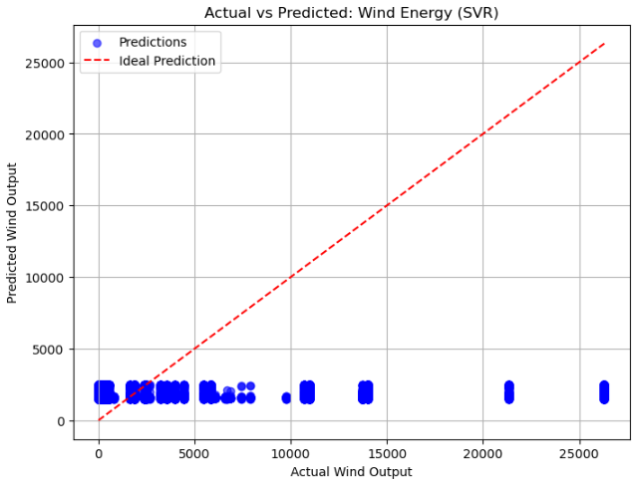
HOME
OBJECTIVE
DATA
METHODOLOGY
RESULTS
CONCLUSION
SUPPORT VECTOR REGRESSION
WIND
R² Score: -0.3229566779132307
Mean Absolute Error (MAE): 5451.2055824548015
Mean Squared Error (MSE): 68561657.51281585
Root Mean Squared Error (RMSE): 8280.19670737452
Managed wind energy variability better than other models but still underperformed.
Slightly reduced error, offering the most conservative estimates among all models.
R² = -0.3229 | RMSE = 8,280.20
Insights:
Stable error handling provides a baseline for risk-averse projections.
Does not deliver high-confidence outputs but useful for preliminary conservative planning.
Best among the current models for wind, though still insufficient for strategic forecasting.

Slide 12

HOME
OBJECTIVE
DATA
METHODOLOGY
RESULTS
CONCLUSION
SOLAR VS WIND PERFORMANCE
Model | Solar R² | Wind R² | Best Performing Metric
Linear Regression | 0.0366 | 0.0091 | Neither – failed across both
Random Forest | -0.1901 | -0.5194 | Underperformed, overfitting issues
SVR | -0.1575 | -0.3229 | Least error for wind, still limited
Key Takeaways
SVR for wind was the most consistent but still inadequate for accurate forecasting.
No current model sufficiently predicts solar or wind growth for financial decision-making.
Next Steps: Refine features, explore advanced methods (time series, deep learning), and improve data quality.

Slide 13




HOME
OBJECTIVE
DATA
METHODOLOGY
RESULTS
CONCLUSION
ISSUES & IMPROVEMENTS
Future Suggestions
Feature Engineering Enhancements:
Add temporal features (e.g., lagged energy outputs, seasonal indicators).
Integrate real-time weather feeds, policy changes, and grid load data.
Modeling Approach Upgrades:
Explore time-series models (ARIMA, Prophet) or deep learning (LSTM, GRU).
Implement cross-validation with hyperparameter tuning to avoid overfitting.
Data Expansion:
Use longer historical ranges and more detailed regional data.
Include external economic indicators affecting energy demand.
Model Performance Summary
None of the models achieved acceptable accuracy for solar or wind energy forecasting.
Linear Regression failed due to oversimplification of complex environmental factors.
Random Forest overfitted to noise, lacking proper feature alignment with energy outputs.
SVR was slightly more stable for wind but still inadequate for strategic planning.
Key Issues Identified
Lack of granular time-series data (e.g., monthly/yearly trends, lag effects).
Insufficient modeling of weather impacts and investment fluctuations.
Limited feature diversity: no inclusion of real-time grid or policy data.
Models trained on data not rich enough to capture non-linear energy patterns.

Slide 14

HOME
OBJECTIVE
DATA
METHODOLOGY
RESULTS
CONCLUSION
CONCLUSION
Current models are not reliable for accurate forecasting of solar or wind trends.
Substantial model refinement and data enhancement are needed to produce actionable insights.
Predictive energy modeling remains a critical tool for guiding future infrastructure and investment decisions, but requires more advanced techniques and richer data to be effective.

Slide 15


